Slide 1
Go-To-Market Strategy
5 Bold Steps Vision Canvas

Slide 2

Vision Statement
Statement that describes what we hope our new solution will achieve
Enable a great customer experience that maximizes subscriber revenue
Notes:
What is the future state of our company? How are we going to help our customers?

Slide 3
Themes
Essential topics that support our vision
Make the Complex Simple - We believe that less is more. From seamless client self-signup to intuitive customer subscription and simple plan management, our priority is to make the lives of our clients easier and the experience of their customers better.
Go Global, Act Local - We support global expansion by offering local configuration and optimization that removes barriers in order to satisfy the local buying behavior to increase conversion and retention.
Customer Centric - ​We believe that the customer is the focus. When faced with a decision related to our solution, we choose the option that provides the best outcome for our clients. Control, flexibility and convenience are characteristics of our customer-centric approach.
Trusted Expert - Our expertise and vast years of experience enable us to be a trusted advisor to our clients. Our suite of managed service offerings – such as fraud, compliance and global payments – are tools our clients can leverage to grow their business.
Maximize Customer Lifetime Value - We believe ​that customer lifetime value is the key metric of a subscription relationship and our goal is to enable our clients to make informed decisions at the right time. We achieve this by providing the tools our clients can use to accurately measure, monitor and report on the health of their organization and their drivers of success.
Notes:
What are the essential themes supporting our vision?

Slide 4
Supports
Items that strengthen our team as we work towards our vision
Executive Leadership – Executive leadership has prioritized the new subscription platform as they believe it will enable cleverbridge to play a role in the growing subscription economy.
Financial Commitment – The commitment from the executive leadership is backed by a financial commitment that will be used to build the new solution.
Past Experience – cleverbridge brings 12 years of experience from the ecommerce space with our consultative approach to providing localization, compliance and optimization support that leads to increased conversions and revenue for our clients.
Trusted Network Feedback – Through the Early Access Program, we’ll create a network of trusted partners that will provide feedback and validate the direction of our solution.
Marketing Positioning – cleverbridge is recognized as a contender in the subscription space and our coverage by the market supports this.
Notes:
What are the supports that enable us to reach our future?

Slide 5
Challenges
Items that may hinder our team as we work towards our vision
Time To Market – We’re late in taking a subscription offering to market. Most of the players in the subscription billing space have been online for several years now and it will take time before we have a similar product and equal experience to offer new clients.
Subscription Industry Expertise – While we have a breadth of ecommerce experience, we have very little knowledge of what is necessary to support companies delivering their product through a subscription model. This will be a steep learning curve.
Not Thinking Big Enough – Over the last 12 years we have slowly lost our ability to think big and innovate. We now have a tendency to limit ourselves and the ideas we bring forward.
Lack of Motivation – Several less successful projects and multiple reorganizations have impacted the company culture negatively.
Brand Expectation – We’ll be delivering two different solutions (Ecommerce and Subscription) through two different models (Reseller and Service Provider). This may cause confusion for prospects and clients.
Notes:
What are the challenges that hinder us from reaching our future?

Slide 6
5 Bold Steps
Steps we must take to achieve our vision
1. Launch Early Access Program for market feedback
2. Advertise our MVP at a major tradeshow
3. Acquire clients via self-service signup process
4. Integrate non-US centric payment gateways
5. Onboard first client utilizing a business service provider model
Notes:
What are the 5 bold steps to take in order to achieve your vision?

Slide 7
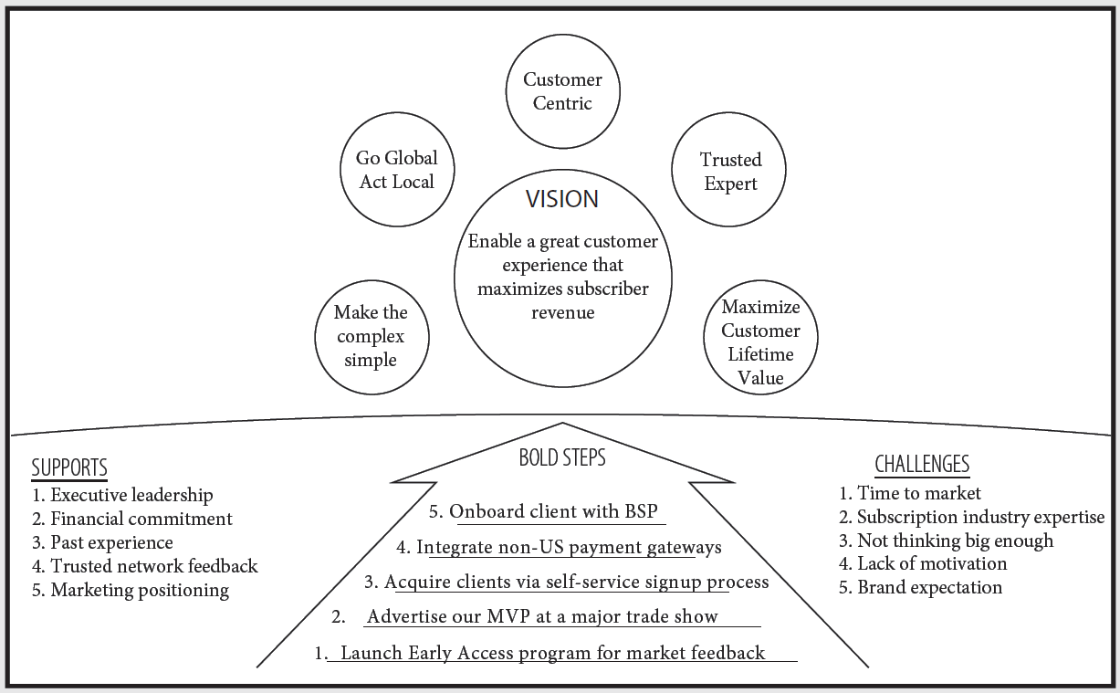
5 Bold Steps Framework

Slide 8
Subscription Platform Release Timeline
MVP Release
Minimum Viable Product
SCOPE
(Basic Functionality)
Simplified Subscription Program based on Fixed Price Model
EARLY ACCESS FOR EARLY ADOPTERS
MMP Release
Minimum Marketable Product
SCOPE
(+Satisfiers)
Globalisation of Sign Ups and Revenue Recovery Programs
SALES PROSPECTING FOR NEW CLIENTS
General Release
Public Product
SCOPE
(+Delighters)
TBD
OFFICIAL MARKETING LAUNCH
MVP Release
MMP Release
General Release 1 (v1.0)
G.R. 2 (v2.0)
Strategy Alignment
Early Access Search
Early Access Live
Sales Prospecting
Marketing Launch
MVP Platform Dev
MMP Platform Dev
G.R. 1 Platform Dev
G.R. 2 PD

